Slide 2
Types of Files and File Access Methods
In general, two types of files
  Text file: contains data that has been encoded as text
  Binary file: contains data that has not been converted to text
Two ways to access data stored in file
  Sequential access: file read sequentially from beginning to end, can’t skip ahead
  Direct access: can jump directly to any piece of data in the file

Slide 3
Opening a file
open function: used to open a file
  Creates a file object and associates it with a file on the disk
  General format:
  file_object = open(filename, mode)
Mode: string specifying how the file will be opened
  Example: reading only ('r'), writing ('w'), and appending ('a’)

Slide 4
Opening a file
Examples:
  customer_file = open('customers.csv', 'r’)
    Opens the file customers.csv and it is stored in the object variable ‘customer_file’
  sales_file = open('sales.txt', 'w’)
    Creates a file named ‘sales.txt’ and can write data to it through the object variable ‘sales_file’
    NOTE: if a file with the same name exists in the current directory, it will be overwritten.

Slide 5

Specifying the Location of a File
If open function receives a filename that does not contain a path, assumes that file is in same directory as program
If program is running and file is created, it is created in the same directory as the program
  Can specify alternative path and file name in the open function argument
    Prefix the path string literal with the letter r(stands for “raw” and will cause the backslashes in the string to be interpreted as actual backslashes)
    test_file = open(r'C:\Users\Blake\temp\test.txt', 'w')

Slide 6
Writing Data to a File
Method: a function that belongs to an object
  Performs operations using that object
  String object has many methods - https://www.w3schools.com/python/python_ref_string.asp
  Example:
    name = input(“what is your name? ”)
    print(name.capitalize())

Slide 7
Writing Data to a File
File object’s write method used to write data to the file
  Format: file_variable.write(string)
File should be closed using file object close method
  Format: file_variable.close()

Slide 8
Concatenating a Newline to and Stripping it From a String
In most cases, data items written to a file are values referenced by variables
  Usually necessary to concatenate a '\n' to data before writing it
    Carried out using the + operator in the argument of the write method
In many cases need to remove '\n' from string after it is read from a file
  rstrip method: string method that strips specific characters from end of the string

Slide 9
Concatenating a Newline to and Stripping it From a String
CONCATENATING A NEW LINE CHARACTER
# Open a file named friends.txt.
myfile = open('friends.txt', 'w')
# Write the names to the file.
myfile.write(name1 + '\n’)
myfile.write(name2 + '\n’)
myfile.write(name3 + '\n’)
STRIPPING THE NEW LINE CHARACTER
name = 'Joanne Manchester\n'
name = name.rstrip('\n')

Slide 10
Exercise:
# This program writes three lines of data
# to a file.
def main():
# Open a file named philosophers.txt.
outfile = {your code here}
# Write the names of three philosphers to the file –
# John Locke, David Hume and Edmund Burke
{your code here}
# Close the file.
{your code here}
# Call the main function.
main()

Slide 11
Reading Data From a File
read method: file object method that reads entire file contents into memory
  Only works if file has been opened for reading
  Contents returned as a string
  Format: file_variable.read()
readline method: file object method that reads a line from the file
  Line returned as a string, including '\n'
Read position: marks the location of the next item to be read from a file

Slide 12
Example:
# This program reads and displays the contents
# of the philosophers.txt file.
def main():
# Open a file named philosophers.txt.
infile = {your code here}
# Read the file's contents.
file_contents = {your code here}
# Print the data that was read into memory.
{your code here}
# Call the main function.
main()

Slide 13
Example 2 using readline method:
# This program reads the contents of the
# philosophers.txt file one line at a time.
REPLACE
# Read the file's contents.
file_contents = infile.read()
WITH
# Read three lines from the file.
line1 = infile.readline()
line2 = infile.readline()
line3 = infile.readline()

Slide 14
Appending Data to an Existing File
When open file with 'w' mode, if the file already exists it is overwritten
To append data to a file use the 'a' mode
  If file exists, it is not erased, and if it does not exist it is created
  Data is written to the file at the end of the current contents
  Exercise – append your name to the bottom of the philosophers.txt file

Slide 15
Writing and Reading Numeric Data
Numbers must be converted to strings before they are written to a file
str function: converts value to string
Number are read from a text file as strings
  Must be converted to numeric type in order to perform mathematical operations
  Use int and float functions to convert string to numeric value

Slide 16
Using Loops to Process Files
Files typically used to hold large amounts of data
  Loop typically involved in reading from and writing to a file
Often the number of items stored in file is unknown
  The readline method uses an empty string as a sentinel when end of file is reached
    Can write a while loop with the condition
    while line != ''

Slide 17
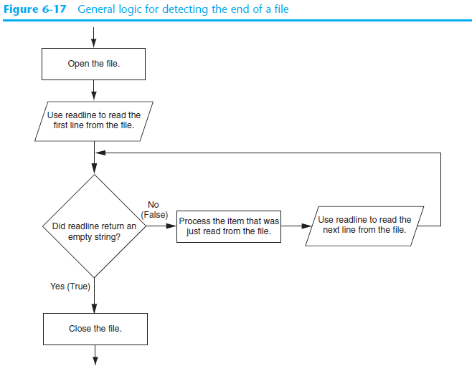

Slide 18
Using Python’s for Loop to Read Lines
Python allows the programmer to write a for loop that automatically reads lines in a file and stops when end of file is reached
  Format: for line in file_object:
  statements
  The loop iterates once over each line in the file
  Exercise – read the clients.txt file and print each client one at a time with a sequence number –
    1. Alfreds Futterkiste

Slide 19
Using the CSV module
Python has a module that is able to read csv files that is delivered as part of its standard library
To use – import csv
Csv.reader({file_object}, {delimiter})
You can read a line/record one at a time and perform operations or calculations at the record level using a for loop

Slide 20
Exercise
Import the customers.csv file using the csv module. Read it and create a new file with only the full customer name and country they are from. Display the total number of customers read from the file.
Name the new file – customer_country.csv

Slide 21
Exercise
Read the file – EmployeePay.csv using the CSV module in Python. Using the data in this file, print out details for each employee along with total pay which should include their bonus (has to be calculated). The program should also pause after each employee until the user hits a key.

